Slide 1

Final Review of Mini Project”
for E-3 2017 Admitted Batch
Submitted as part of Mini Project.
G. Sunil Kumar – S170904
G. Sahithi Lahari – S170034
L. Deepika – S170341
Under the Supervision of:
Mr. Ch. Satish Kumar
Asst prof RGUKT Srikakulam
Department of Computer Science and Engineering
Rajiv Gandhi University of Knowledge Technologies
Srikakulam – 532402
1

Slide 2
Dynamic Mail Labeller
An extension through Extension

Slide 3
Table of Contents
Abstract
Introduction
Motivation of the Project
Scope of Project
How it will work?
Analysis of Existing Methods/Models/Algorithms
Technologies Used
Results and Analysis
Screenshots
Conclusion
References

Slide 4
Abstract
We encounter several system and application changes on a regular basis. The main reason for this is to implement new modifications that make work easier and less time and space consuming. On that topic, our project Dynamic Mail labeller is a method of labelling every mail for simpler management and identification. We are all aware that Gmail is the most often used application for transferring communications, whether professional or personal. We receive a large number of emails every single day. There is a chance that after a few days we may need a certain email and will need to look for it, which is a time consuming operation. Labelling is an existing function in Gmail that allows us to give labels to each email and add them to the appropriate category. And anytime we can classify emails automatically since we have filters that respect it. The issue here is that we must do this procedure manually for each and every message that has to be classified. As a result, we aim to tackle this by employing a mail labeller chrome plugin. It produces filters and assigns labels dynamically. It produces filters depending on the email’s FROM addresses | Sub | Content and other variables.
Index Terms – Mail Labelling, Mail Classification, Mail Filters, Chrome Plugins

Slide 5
Introduction
We all are aware that Gmail is the most widely used application for transferring messages, whether professional or personal. We receive a large number of emails every single day. There is a chance that after a few days we will need a specific email and will have to search for it, which is a time-consuming process.
On that note, everyone uses labels to categorize their mails. The issue here is that we must perform this process manually for each and every mail that needs to be classified.
Keeping the foregoing in mind, we wanted to create a chrome extension that automates labelling and has advanced ways to categorize them.

Slide 6
Motivation of Project Work
We decided to create a Chrome extension that would be useful to all email users to overcome the below mentioned issues:
E-mail categorization is difficult to achieve every time.
To categorize each email, we must manually create filters/labels.
There is currently no solution for the aforementioned issues, so we are developing a chrome extension tool that will dynamically create labels and assign labels to e-mails.

Slide 7
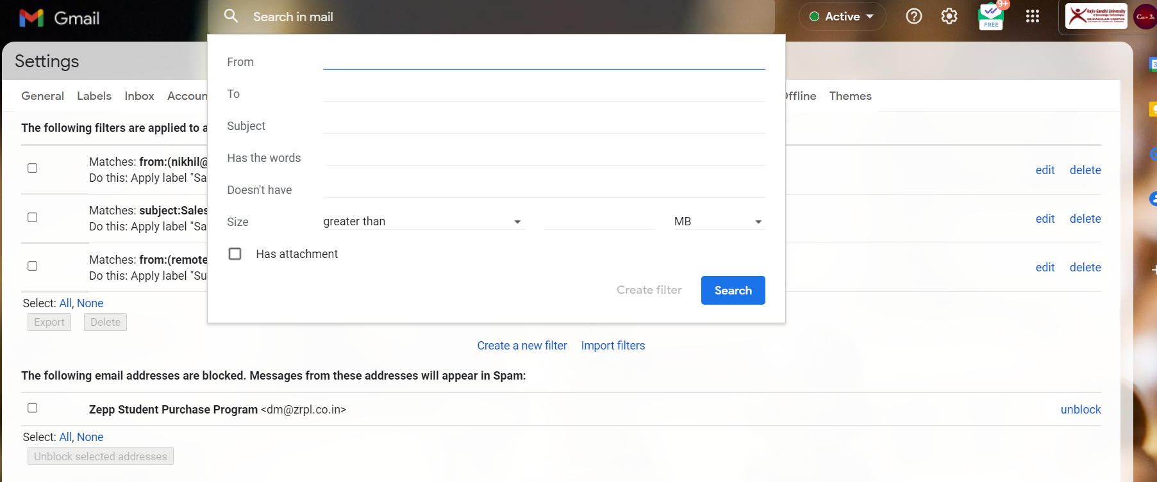
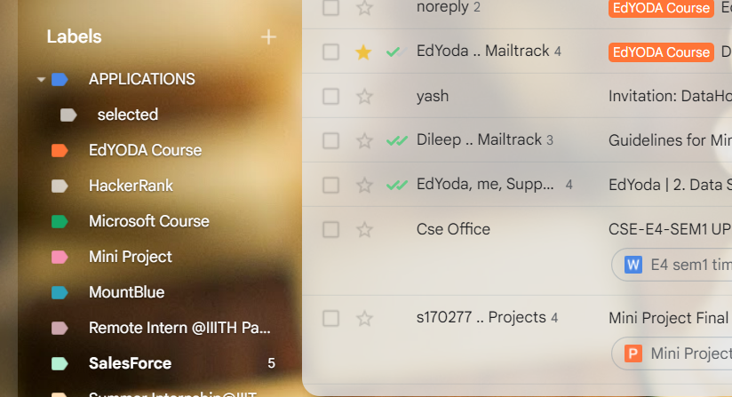
Analysis of Existing Methods/Models/Algorithms
Gmail has a labelling feature that enables us to assign labels to each email and add it to the relevant category. And whenever we have filters that respect to it, we can automatically classify emails. The problem is that we have to do this process manually for creating the filters.

Slide 8
Scope of Project
We are mainly focusing on every mail user to make their labels categorized.
We are developing a chrome extension which will ease the user to categorize their mails.
It will be available in google chrome extensions where the mail user needs to add that extension to their chrome.

Slide 9
Technologies Used
IMAP TOOLS (Python library)
NLP(Natural Language Processing) using Python
JavaScript
HTML
CSS

Slide 10

How it will work?

Slide 11
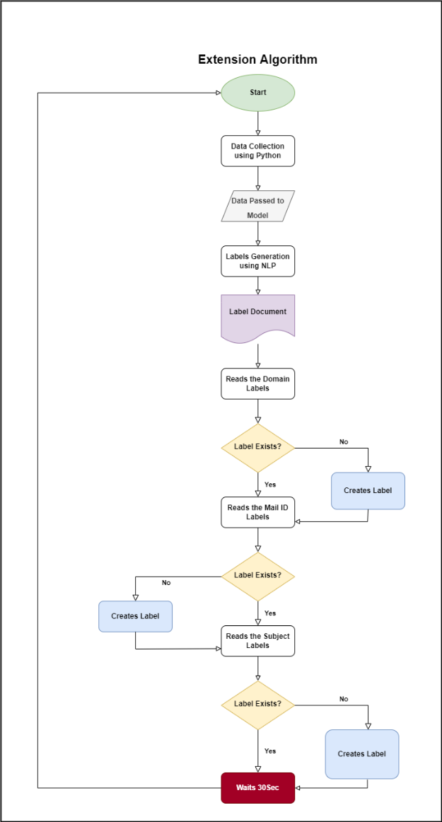
Working of Dynamic Mail Labeller

Slide 12
Results and Analysis
For every single received email the Dynamic Mail Labeller is generating three labels based on Domain Address, Mail_id without domain and subject.
The labels are nested to one another, i.e.,
Domain Labels
Mail_id Labels
Subject Labels

Slide 13
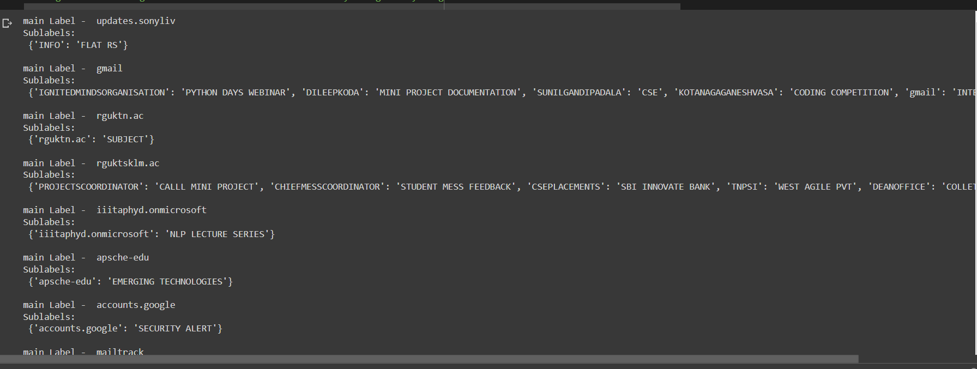
Results and Analysis

Slide 14
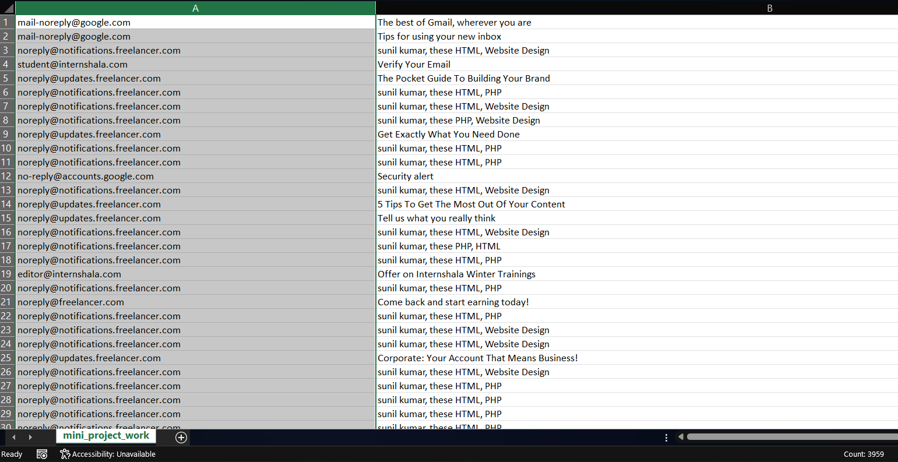
Screenshots of Results
Data Collection

Slide 15
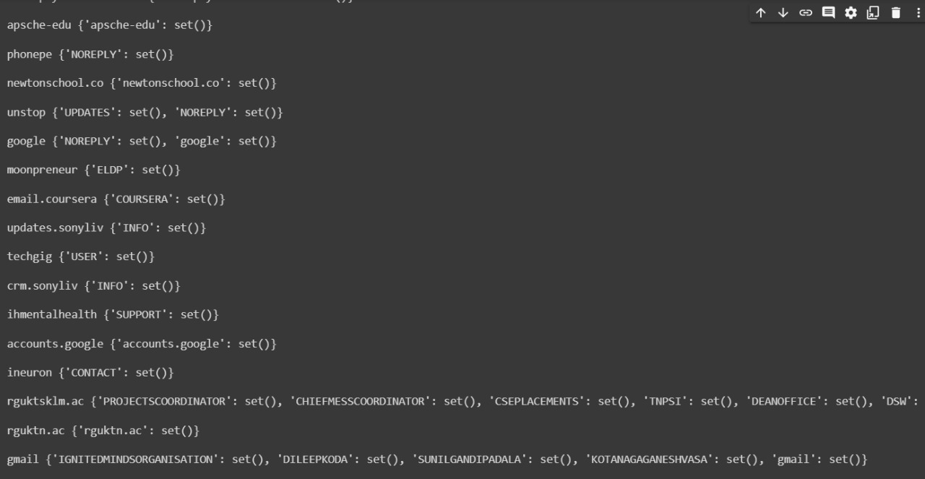
Screenshots of Results
LABELS BASED ON FROM ADDRESSES

Slide 16
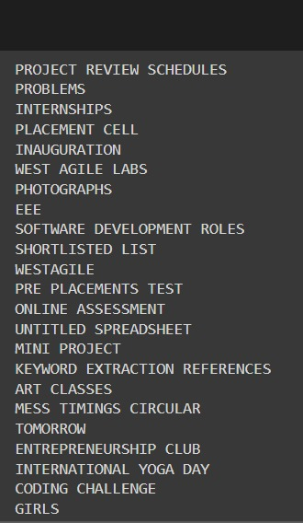
Screenshots of Results
LABELS BASED ON SUBJECTS

Slide 17
Conclusion
To sum up with, Dynamic Mail Labelling is a easy to install and very useful chrome extension that will be very beneficial to all the gmail users. It enhances productivity and takes less time consuming for the tasks like mail filtering and labelling.

Slide 18
References
Reading the Data
https://deviloper.in/how-to-read-emails-using-python
https://www.freecodecamp.org/news/web-scraping-python-tutorial-how-to-scrape-data-from-a-website/
To make Labelling Model
https://medium.com/@raghavaggarwal0089/bi-lstm-bc3d68da8bd0
https://towardsdatascience.com/extracting-keywords-from-short-text-fce39157166b
https://www.analyticsvidhya.com/blog/2022/01/four-of-the-easiest-and-most-effective-methods-of-keyword-extraction-from-a-single-text-using-python/
To make Extension
https://pythonspot.com/create-a-chrome-plugin-with-python/

Slide 19
Thank You

